Slide 1
Optical Vinyl Disc Player
Design and construction of
Supervisor: Professor Andrew S Holmes

Slide 2
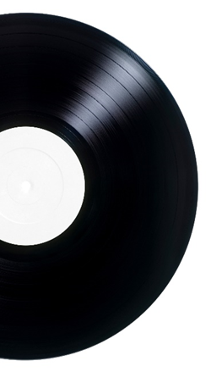
Overview
Background
Project aims
Principles of operation
Hardware implementation
Software implementation
Introducing OVDP
Summary and conclusions
Future work
Questions and product demo
Overview

Slide 3
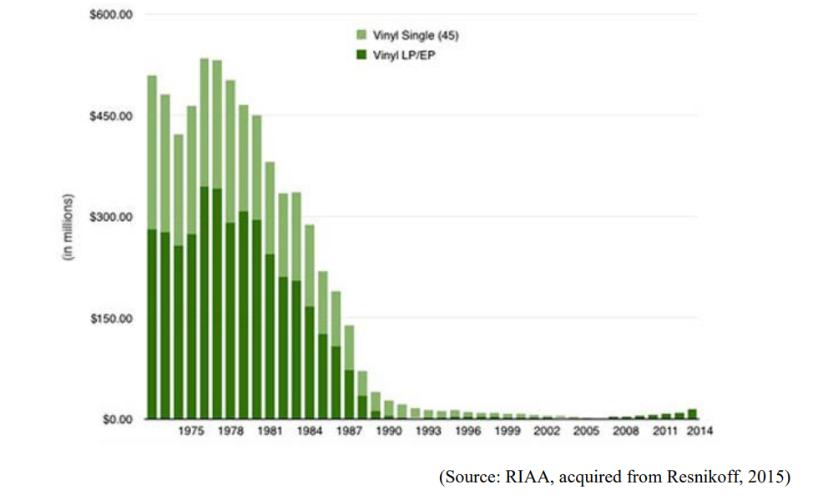
Background
Vinyl disc dominates the music market from the 1960s to the 1980s
The demand for vinyl discs increases after the 2000s.

Slide 4
Background
Shellac Discs: could contain valuable audio contents
The pressure of the needles of a gramophone to a shellac record is about 128g.
The needle of a gramophone needs to be changed after playing one side.
One Shellac Disc is designed to be played around 30 times.
Vinyl Discs: could be valuable collections
The temperature of a stylus tip while playing a vinyl disc can be up to 200℃.
One ‘Skating’ could result in permanent ‘Skating’ in the future
Not well-balanced tonearm could wear the record severely
Playing a vinyl disc about 100 times results in about a 2dB reduction in high frequency.
DJ scratching cause permanent damage to the vinyl discs.

Slide 5

Project aims
Basic:
Play 33.3 RPM vinyl record in stereo without contact with the record.
Advance:
Play faster RPM
Improve audio quality
Play warped and broken discs
Project
Aims

Slide 6

Project aims
Libraries and Archeologists:
Recover audio from fragile and nonplayable discs
Vinyl collectors
Enjoy their valuable collections without damaging them
DJs:
Do scratching without scratching the discs.

Slide 7
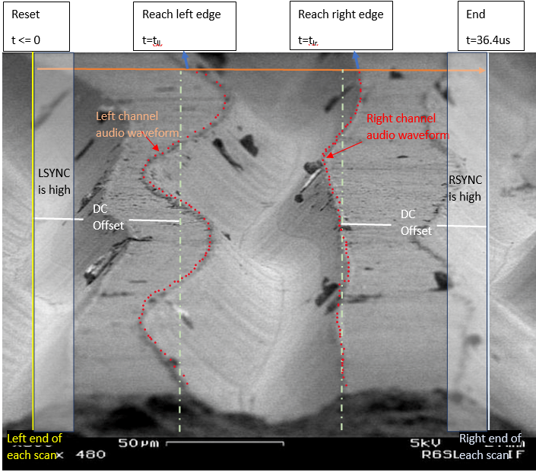
Principles of operation

Slide 8
Hardware implementation: READ HEAD
Output SIGNAL Data
Fibre
laser
Oscillating
micro-mirror
Beam splitter
50µm
SIGNAL
photodiode
SYNC
photodiodes
Record grooves

Slide 9
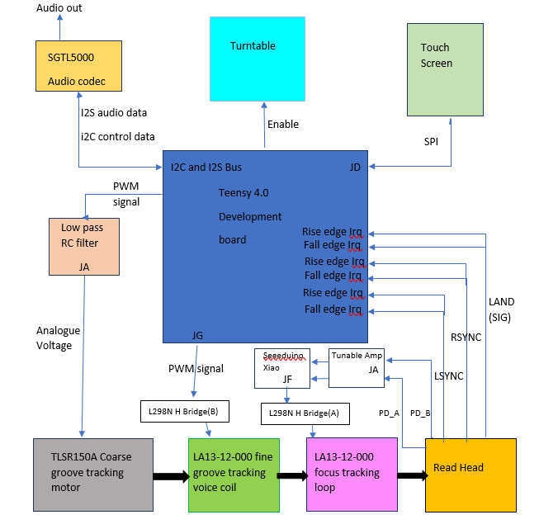
Hardware implementation: Top view

Slide 10
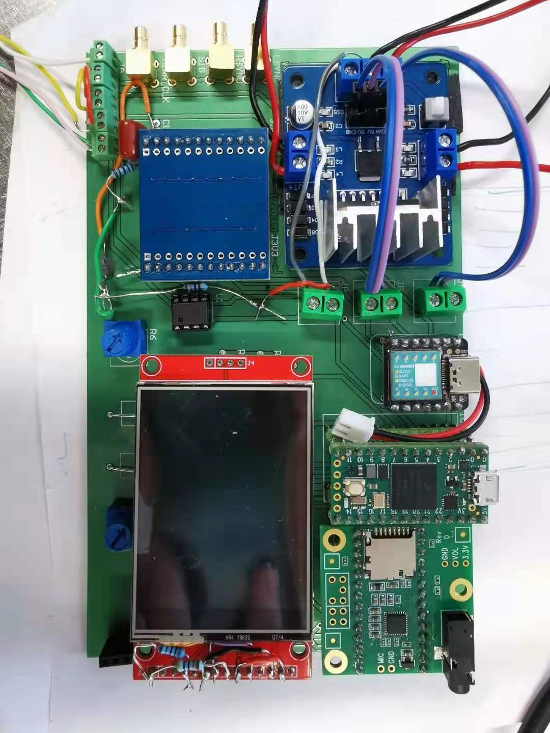
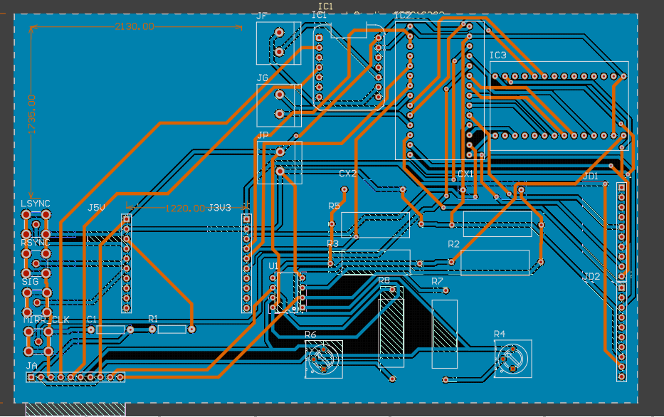
Hardware implementation: PCB board

Slide 11
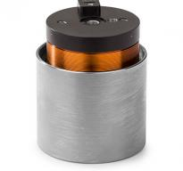
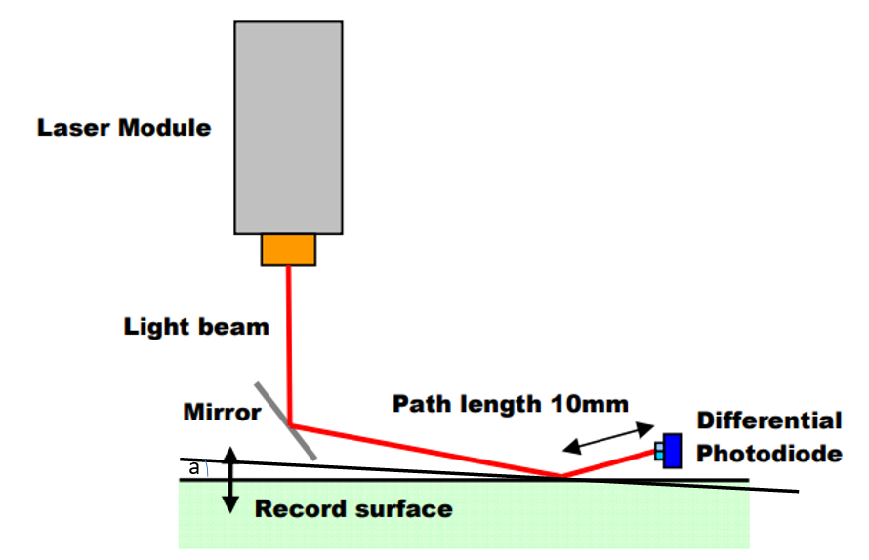
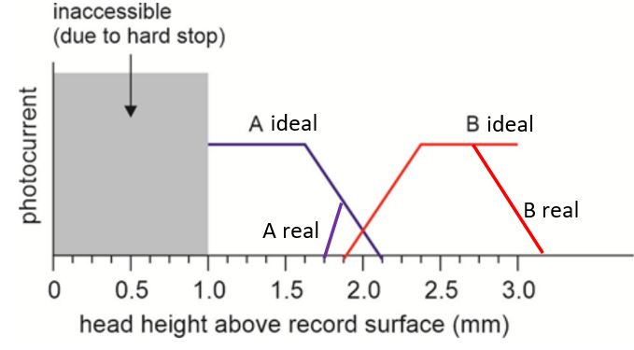
Hardware implementation: Focus
Flexure voice coil attenuator (vertical)

Slide 12
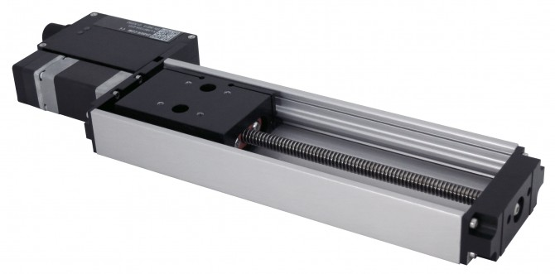
Hardware implementation: Groove tracking
Flexure voice coil attenuator (horizontal)
Linear stage stepper motor with built-in driver.

Slide 13
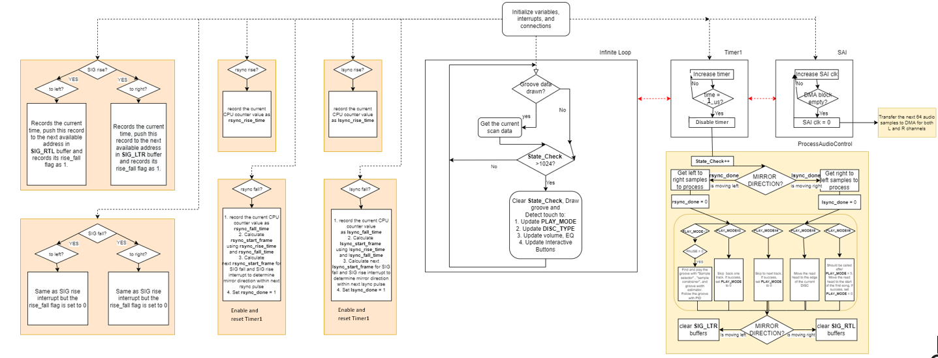
Software implementation: Top view

Slide 14
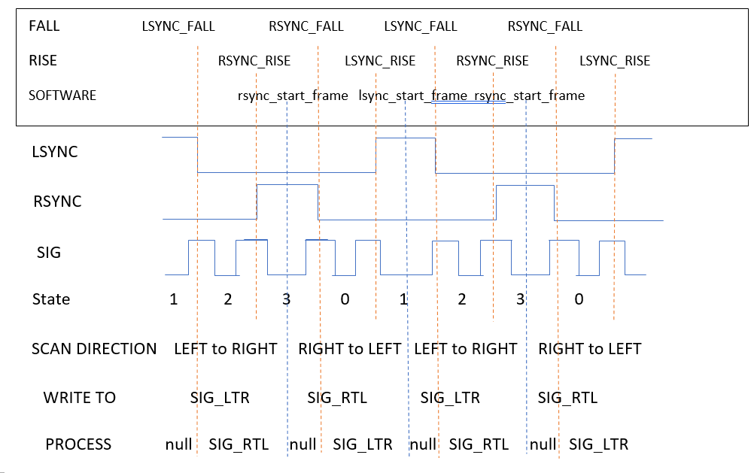
Software implementation: Data Structure

Slide 15
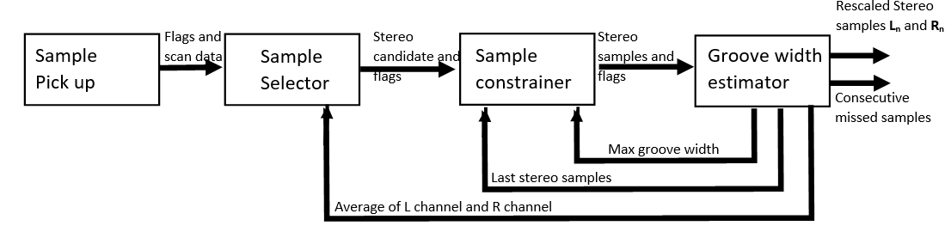
Software implementation: Audio Pick Up
1. Pick the same groove 2. Pick consistent L-R channel
3. Work with variable groove width 4. Reject glitches
5. take logs 6. Fault correction

Slide 16
Software implementation: Audio Pick Up
1. Pick the same groove 2. Pick consistent L-R channel
3. Work with variable groove width 4. Reject glitches
5. take logs 6. Fault correction

Slide 17
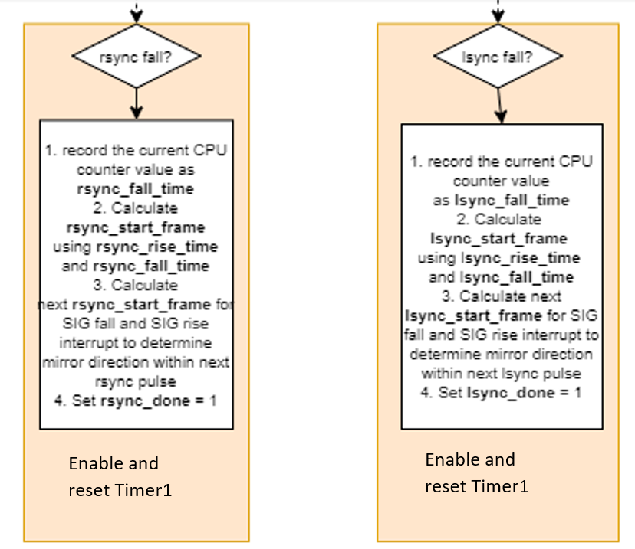
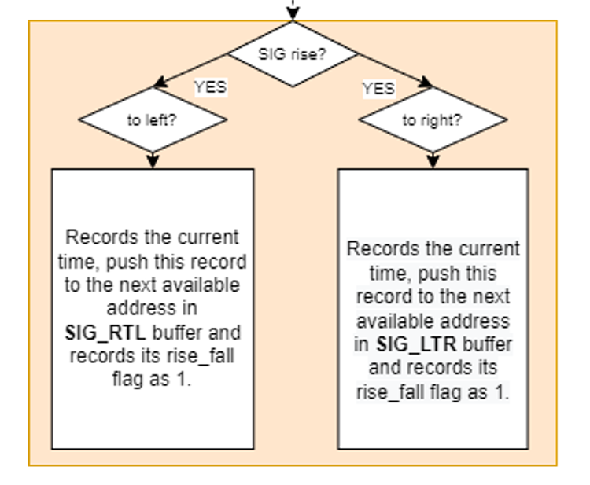
Audio Pick Up: Sample pick up

Slide 18
Software implementation: Audio Pick Up
1. Pick the same groove 2. Pick consistent L-R channel
3. Work with variable groove width 4. Reject glitches
5. take logs 6. Fault correction

Slide 19
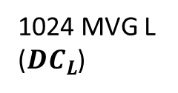
Audio Pick Up: Sample selection
Selected
Rejected
1024 MVG L
(${DC}_{L}$)

Slide 20
Software implementation: Audio Pick Up
1. Pick the same groove 2. Pick consistent L-R channel
3. Work with variable groove width 4. Reject glitches
5. take logs 6. Fault correction

Slide 21
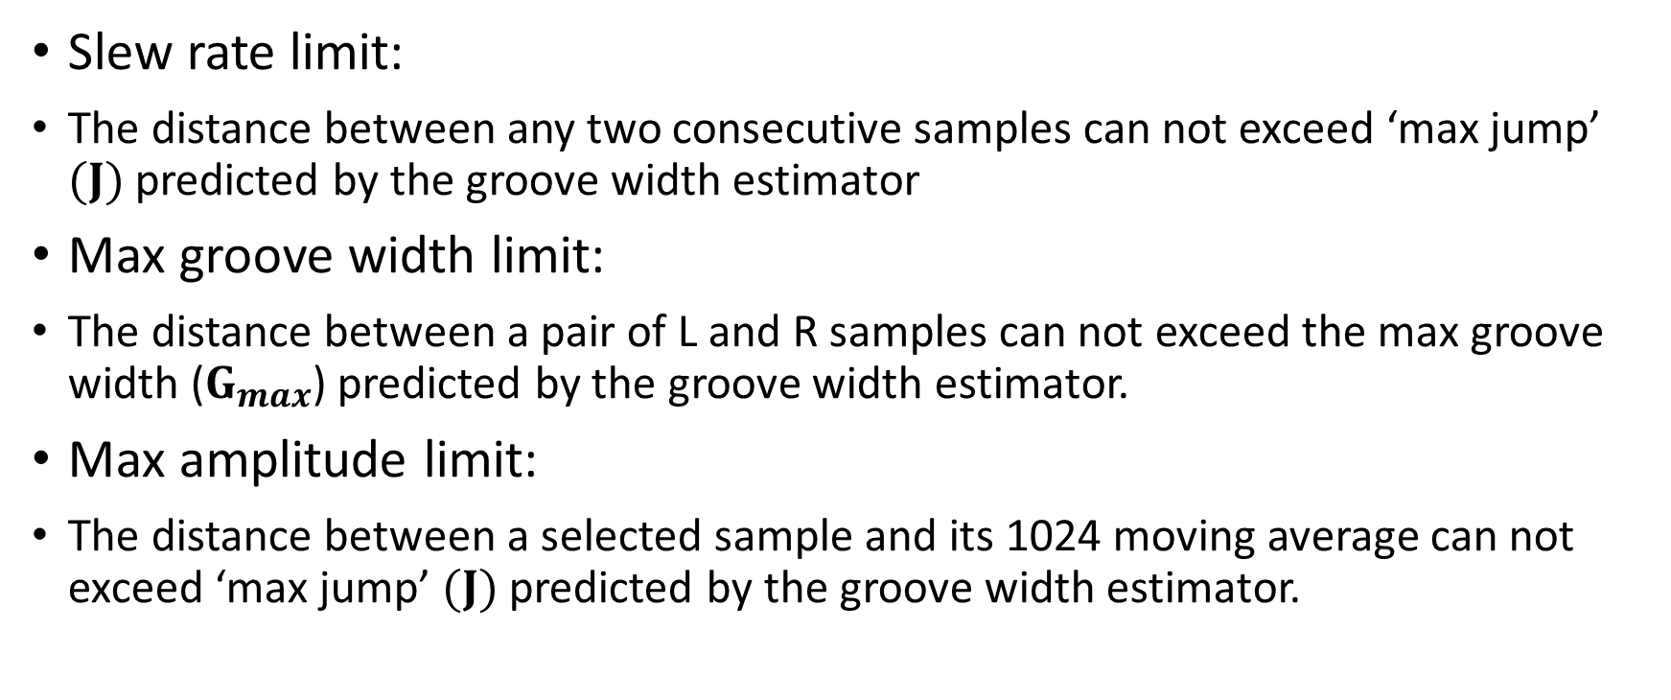
Audio Pick Up: Sample Constrainer
Slew rate limit:
The distance between any two consecutive samples can not exceed ‘max jump’ $(J)$ predicted by the groove width estimator
Max groove width limit:
The distance between a pair of L and R samples can not exceed the max groove width ($G_{max}$) predicted by the groove width estimator.
Max amplitude limit:
The distance between a selected sample and its 1024 moving average can not exceed ‘max jump’ $(J)$ predicted by the groove width estimator.

Slide 22
Software implementation: Audio Pick Up
1. Pick the same groove 2. Pick consistent L-R channel
3. Work with variable groove width 4. Reject glitches
5. take logs 6. Fault correction

Slide 23
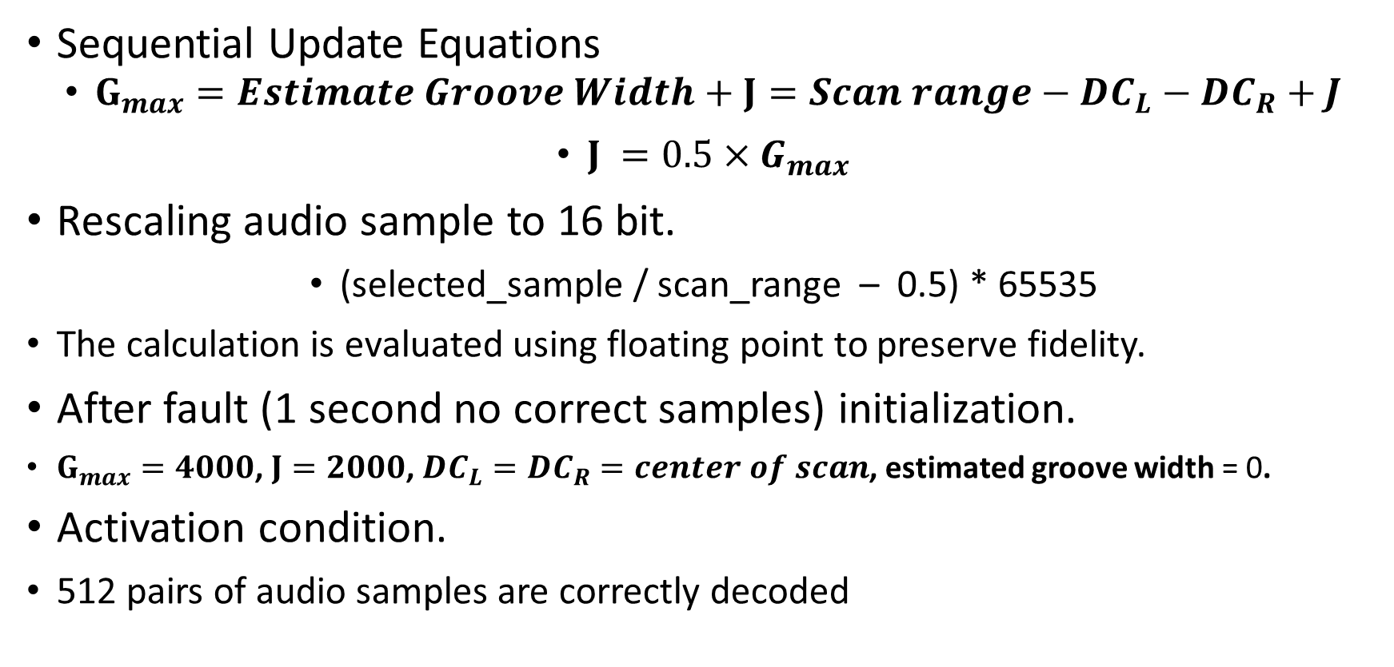
Audio Pick Up: Groove width estimator
Sequential Update Equations
$G_{max}=Estimate Groove Width+J={Scan range−DC}_{L}−{DC}_{R}+J$
$J =0.5×G_{max}$
Rescaling audio sample to 16 bit.
(selected_sample / scan_range – 0.5) * 65535
The calculation is evaluated using floating point to preserve fidelity.
After fault (1 second no correct samples) initialization.
$G_{max}=4000$, $J=2000$, ${DC}_{L}={DC}_{R}=center of scan$, estimated groove width = 0.
Activation condition.
512 pairs of audio samples are correctly decoded

Slide 24
Software implementation: Audio Pick Up
1. Pick the same groove 2. Pick consistent L-R channel
3. Work with variable groove width 4. Reject glitches
5. take logs 6. Fault correction

Slide 25
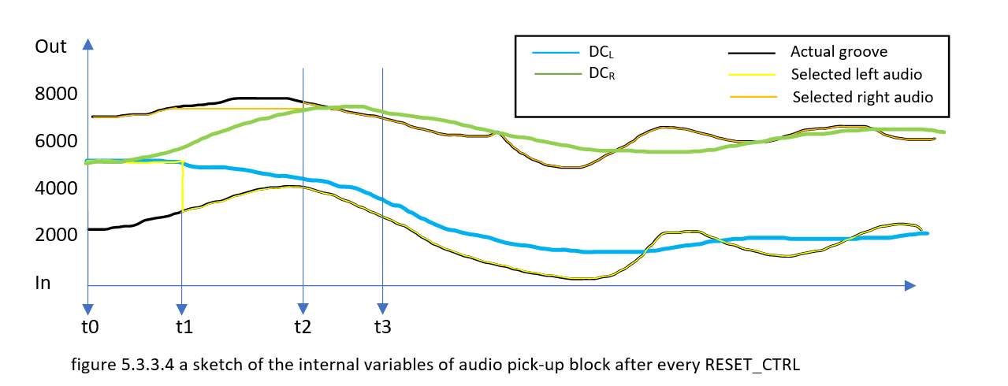
Audio Pick Up: whole block

Slide 26
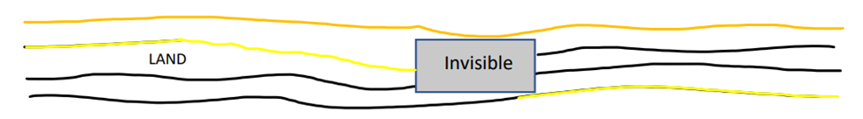
Audio Pick Up: Fault correction
LTR RTL
0 3
1 2
2 1
3 0
Skip dust, but correct mismatched L-R pairs
Accumulate N of occurrence of the case “nonconsecutive indexes”
Accumulator reaches a threshold, start correction and disable the constrainer
The threshold is determined by dust size.
Threshold 50 for dust size up to 200um.

Slide 27
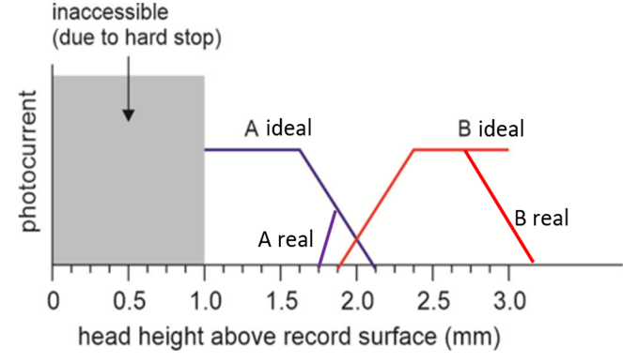
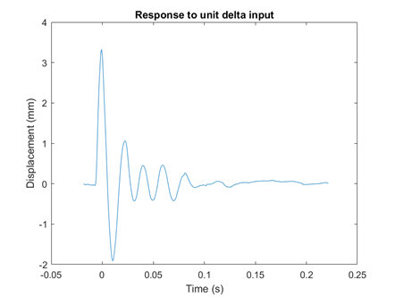
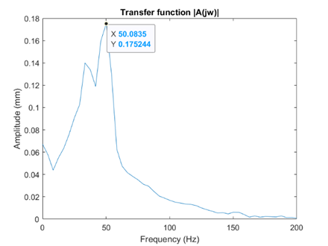
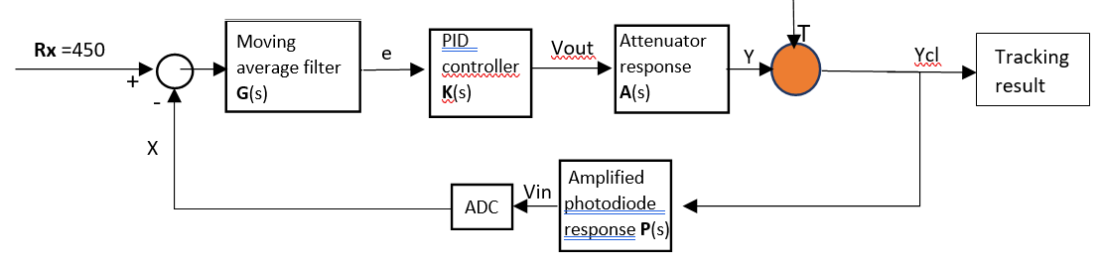
Software Implementation: Focus Tracking

Slide 28
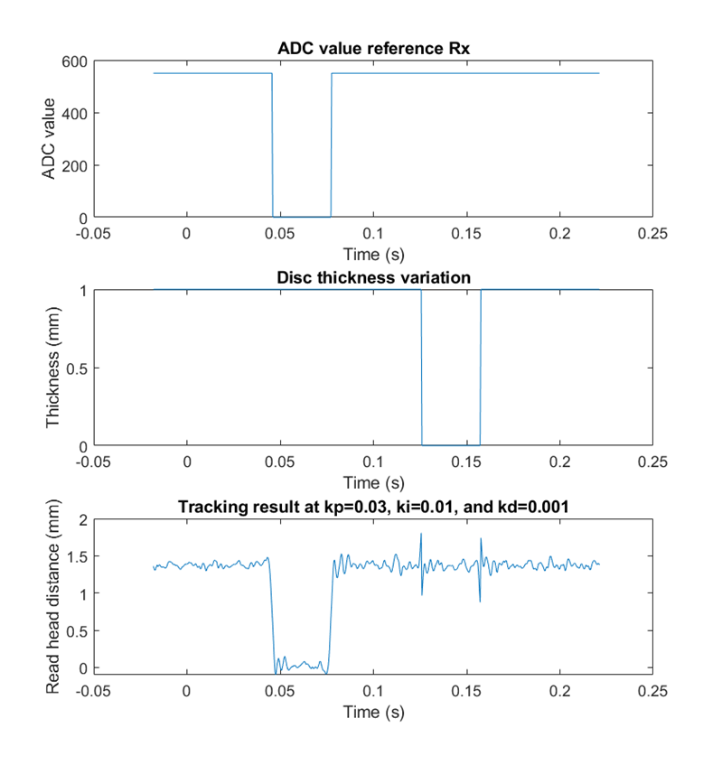
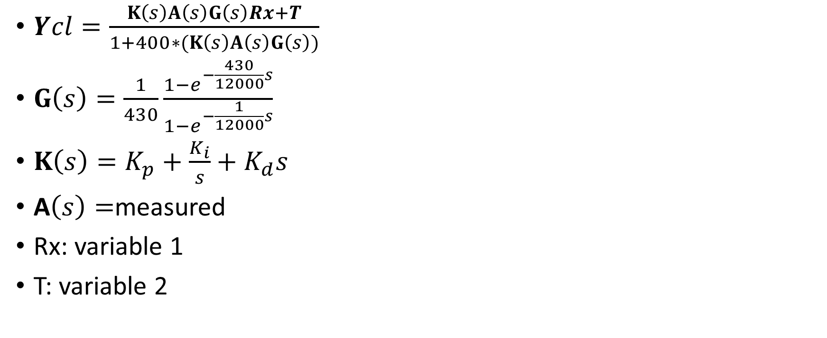
Software Implementation: Focus Tracking
$Ycl=\frac{K\left(s\right)A\left(s\right)G\left(s\right)Rx+T}{1+400∗(K\left(s\right)A\left(s\right)G\left(s\right))}$
$G\left(s\right)=\frac{1}{430}\frac{1−e^{−\frac{430}{12000}s}}{1−e^{−\frac{1}{12000}s}}$
$K\left(s\right)=K_{p}+\frac{K_{i}}{s}+K_{d}s$
A$\left(s\right)=$measured
Rx: variable 1
T: variable 2

Slide 29
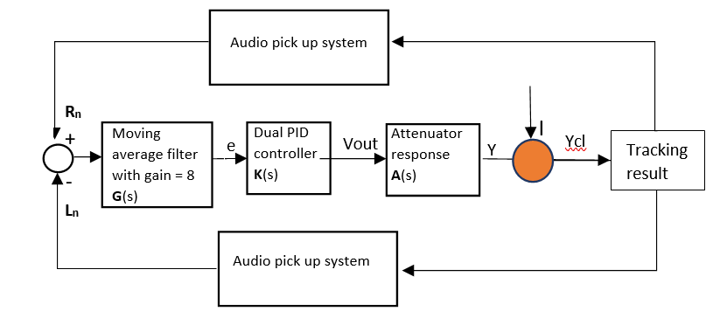
Software Implementation: Groove Tracking

Slide 30
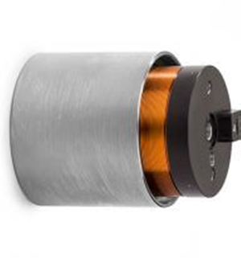
Software Implementation: Groove Tracking
More Ki for spring to reduce steady-state error
More Kp for the linear stage to improve tracking speed

Slide 31
Software Implementation: Audio Enhancer
Resolve the following issues
13.7kHz and white noise present in the audio
Random glitches present in the audio
The audio is too bass-heavy.

Slide 32
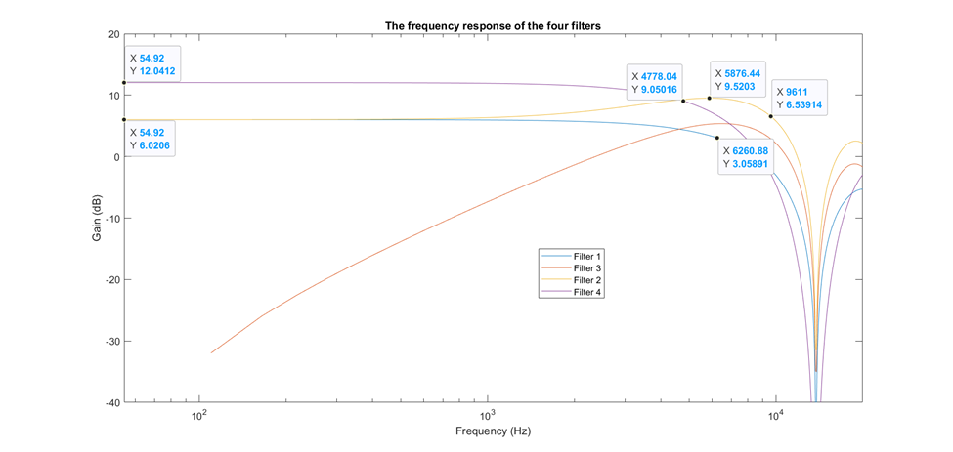
Audio Enhancer: 13.7kHz mirror noise
[0, 1, 1]
[-1, 0, 1]
[-1, 1, 2]
[1, 2, 1]

Slide 33
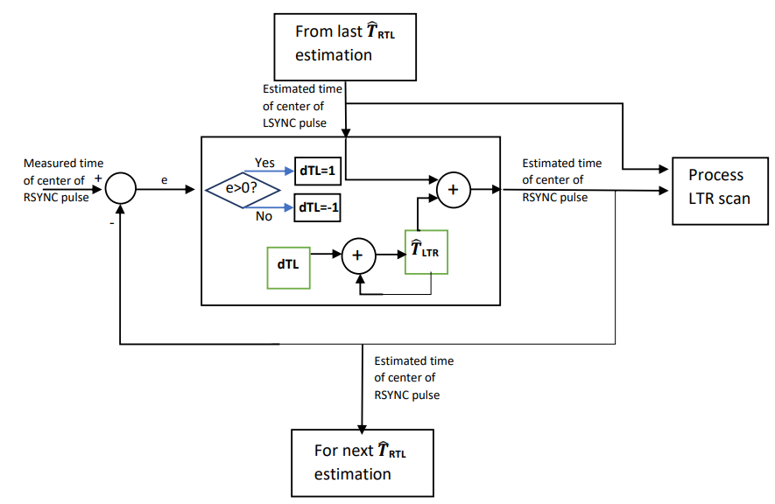
Audio Enhancer: Glitch and white noise
Adaptive frequency lock loop

Slide 34
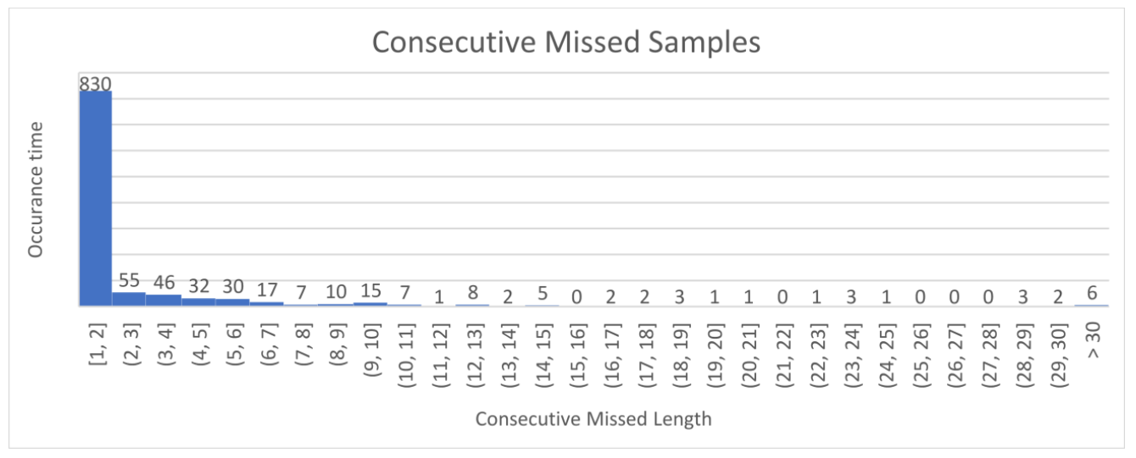
Audio Enhancer: Glitch and white noise
sample extrapolator with max extrapolation length = 7

Slide 35
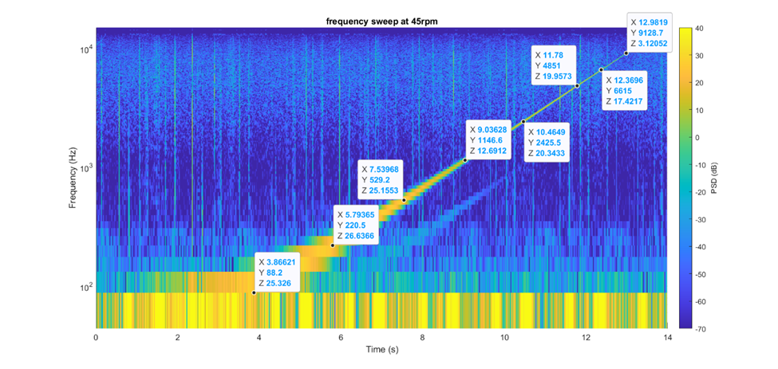
Audio Enhancer: Frequency response
Correct the frequency response
Freq | Gain
115 | -8dB
300 | -8dB
990 | +10dB
3000 | +9dB
9900 | +12dB

Slide 36
Software Implementation: Timing analysis
Functions | CPU Cycles | Latency | Priority
Capturing the rise of any SYNC | 4 | 11 | 16
Capturing the fall of any SYNC and initialize Timer1 | 212 | 11 | 16
Capturing the rise or fall of SIG | 36 | 11 | 16
Process audio (10 edges) and groove control | 1621 | 13 | 128
Display (idle) | Remaining | None | Lowest
The total CPU cycles within one LTR or RTL is 21898 cycles. Time to process non idle tasks under worse case is 212 + 11 + 4 + 11 + (36 + 11) * 10 + 1621 + 13 = 2342 cycles.
The worse case CPU utilization rate is 2197/21898 = 10.7%.
This means the software can run at higher mirror frequencies.

Slide 37
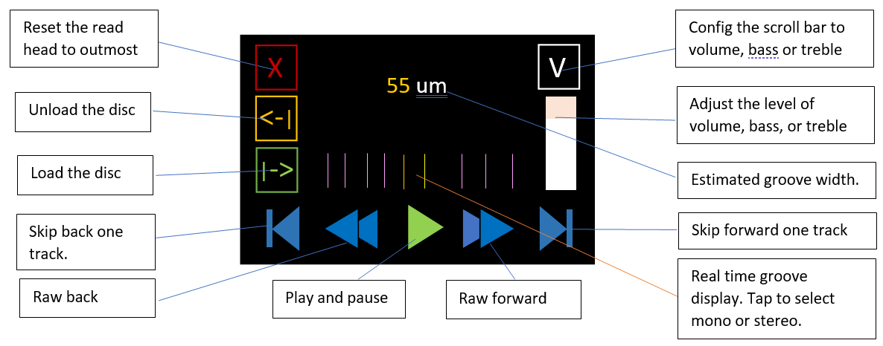
Introducing OVDP

Slide 38
Play vinyl discs
Title | Number of tracks | Color | Speed (RPM) | Brand | Weight | Testing results and description
Freestyle (EPO) | 5 | Black | 33 | MIDI.inc | 140g | All pass. Except for the quiet end at track 4 Issue: invisible edge due to low reflection
Variety (2021) Mariya Takeuchi | 5 | Black | 33 | Warner music | 220g | All pass, but focus control reaches the limit
Woman in red OST Stevie Wonder | 5 | Black | 33 | Motown | 140g | All pass. Disc has a big center hole and has very fast groove width variation.
Friday Magic Meiko Nakahara | 5 | Black | 33 | TOSHIBA EMI | 140g | All pass.
Vitamin E.P.O (EPO) | 5 | black | 33 | AVG.inc | 140g | All pass.
Best Selection 10+1 Meiko Nakahara | 6 | black | 33 | TOSHIBA EMI | 140g | All pass.
Unknown (Fat boy slim) | 1 (Maxi groove) | black | 33 | unknown | 140g | All pass with clipping. Audio signal runs out of scan range due to high amplitude
One last kiss (Utada Hikaru) | 1 (Maxi groove) | Clear blue | 33 | Sony | 180g | All pass. Need to adjust the threshold of the SIG comparator.
Best Album (B) (Hatsumi Shibata) | 7 (Slim groove) | Black | 33 | Columbia | 140g | Poor SNR. Failed at end of some tracks. Issue: invisible edge due to low reflection.
Debussy Nocturnes /Iberia | 3 | Black | 33 | Decca | 180g | All pass, but poor SNR when music is quiet.
Abbey Road (Beatles) | 6 | Black | 33 | EMI | 220g | Only bass is audible.

Slide 39
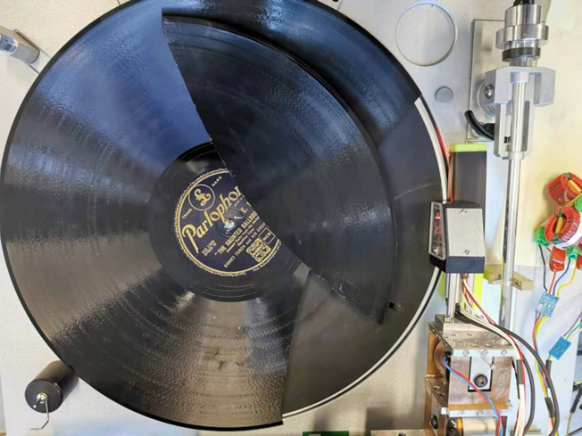
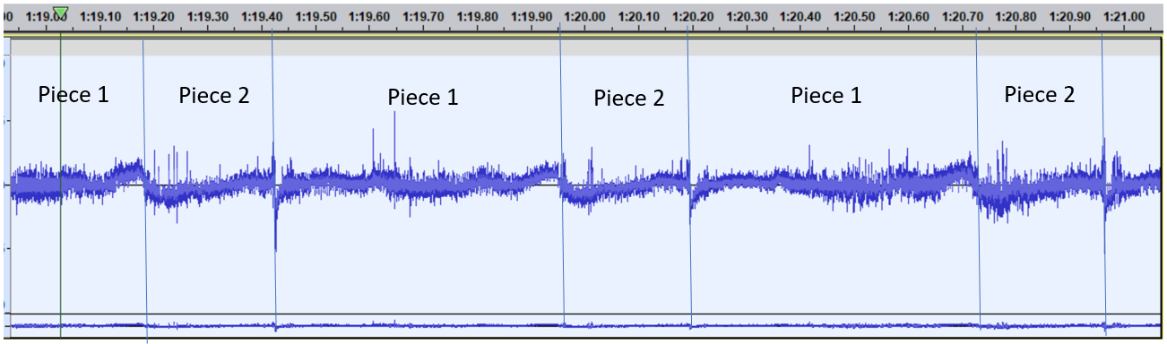
Play cracked shellac disc
Piece 2
Piece 1

Slide 40
Summary and conclusions
Achieved:
Continued stereo or mono playback of a whole side of a vinyl disc
Robust groove tracking up to 100 RPM (center deviation < 1.5mm)
Functions and GUI
Audio quality improved by audio enhancer
PCB design for motherboard
Issue to resolve in future
Poor SNR (< 52dB) for discs with track number > 6
Focus and groove tracking issue at darker dense groove region
Poor high-frequency reproduction

Slide 41

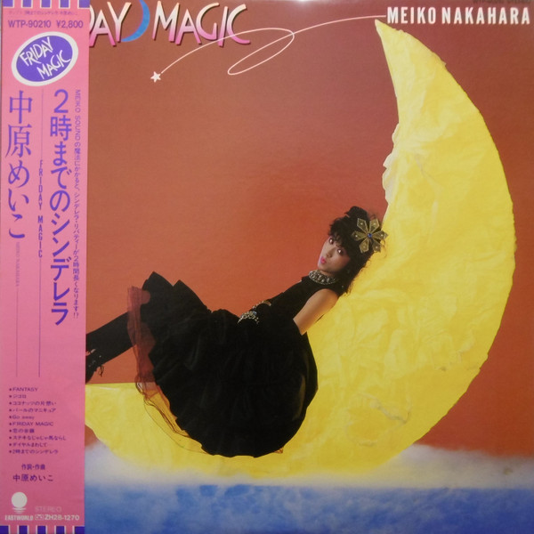
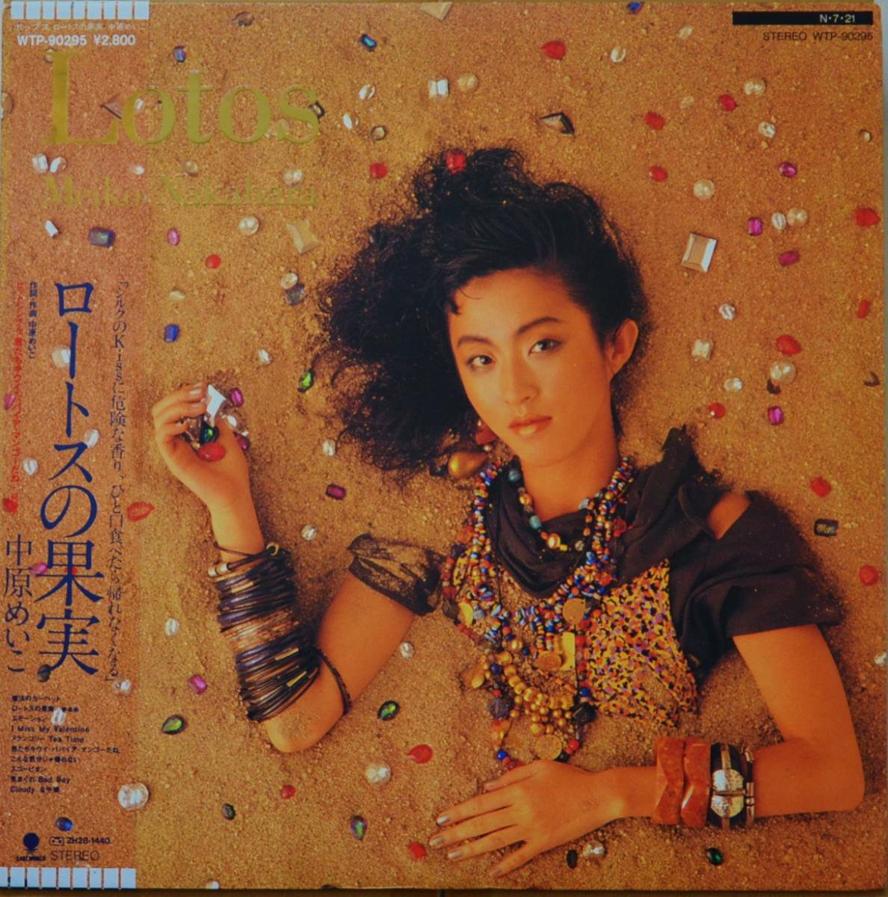
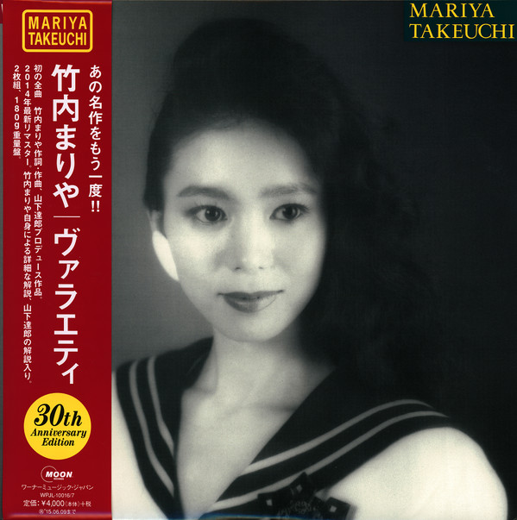

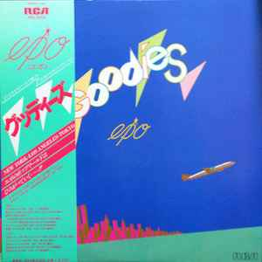

Questions and product demo
Choose one of the following vinyl discs to play
?

